Slide 1
Let’s Get Started
1
Got to www.myhpbenefits.com or Join.virginpulse.com/HP
2
Set up your account
3
Take the meQ Stress Assessment
1

Slide 2
Let’s Get Started
4
Get your profile
Learn your greatest sources of stress, and what aspects of your life are helping you thrive versus what’s holding you back.
5
Begin your personalized program
On your own meQuilibrium journey, you’ll be learning new strategies to help deal with stress by building new skills.
1

Slide 3
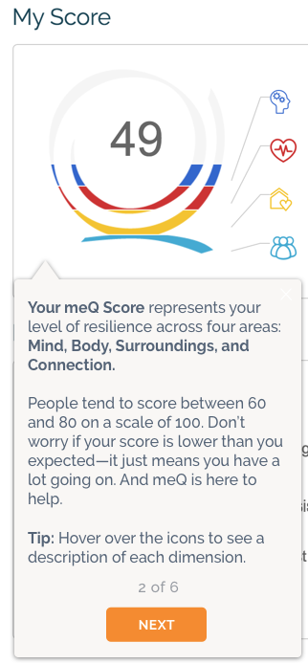
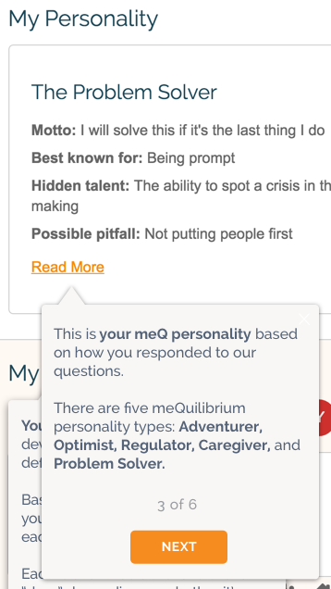
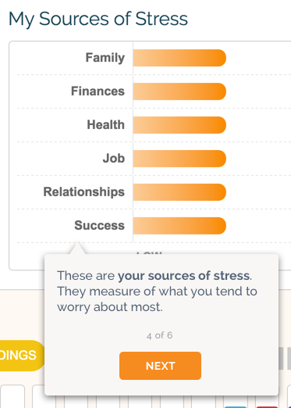
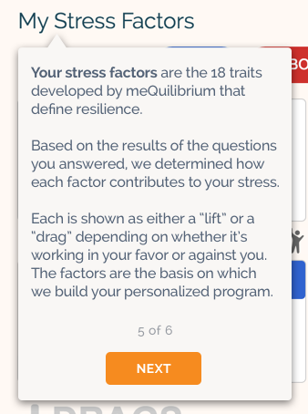
Check Out Your meQ Profile

